Slide 1

ILP 2023 – W6S2-3 Object-Oriented Programming
Matthieu DE MARI Singapore University of Technology and Design

Slide 2
Outline (Week6, Session2-3 – W6S2-3)
From object dictionaries to proper objects
Attributes, methods and constructor method
The __dict__ special attribute
About special methods
Has-a relationship
If time allows,
(Is-a relationship and inheritance)
(Attributes privacy)
(Setters, getters and properties)

Slide 3
What is object-oriented programming?
Object-oriented programming (OOP) is a programming language paradigm organized around custom objects.
Sometimes, the objects we need for our programs cannot be described using only the basic int/float/str/list/dict types.
While it is true that we can assemble variables that relate to the same concept into dictionnaries (what we described as object-oriented thinking)…
We often prefer to create our own custom types/objects.

Slide 4

Our toy example for this class: a video game hero
Let us say we would like to code a video game and design our main character.
Our main character can be represented as a custom class object.
It has several attributes, such as
A name (string type, ‘Sir Meowsalot’)
A class (string type, ‘Warrior’)
Some lifepoints (int types, 100)
Other attributes (intelligence, strength, speed, armor, etc.)

Slide 5
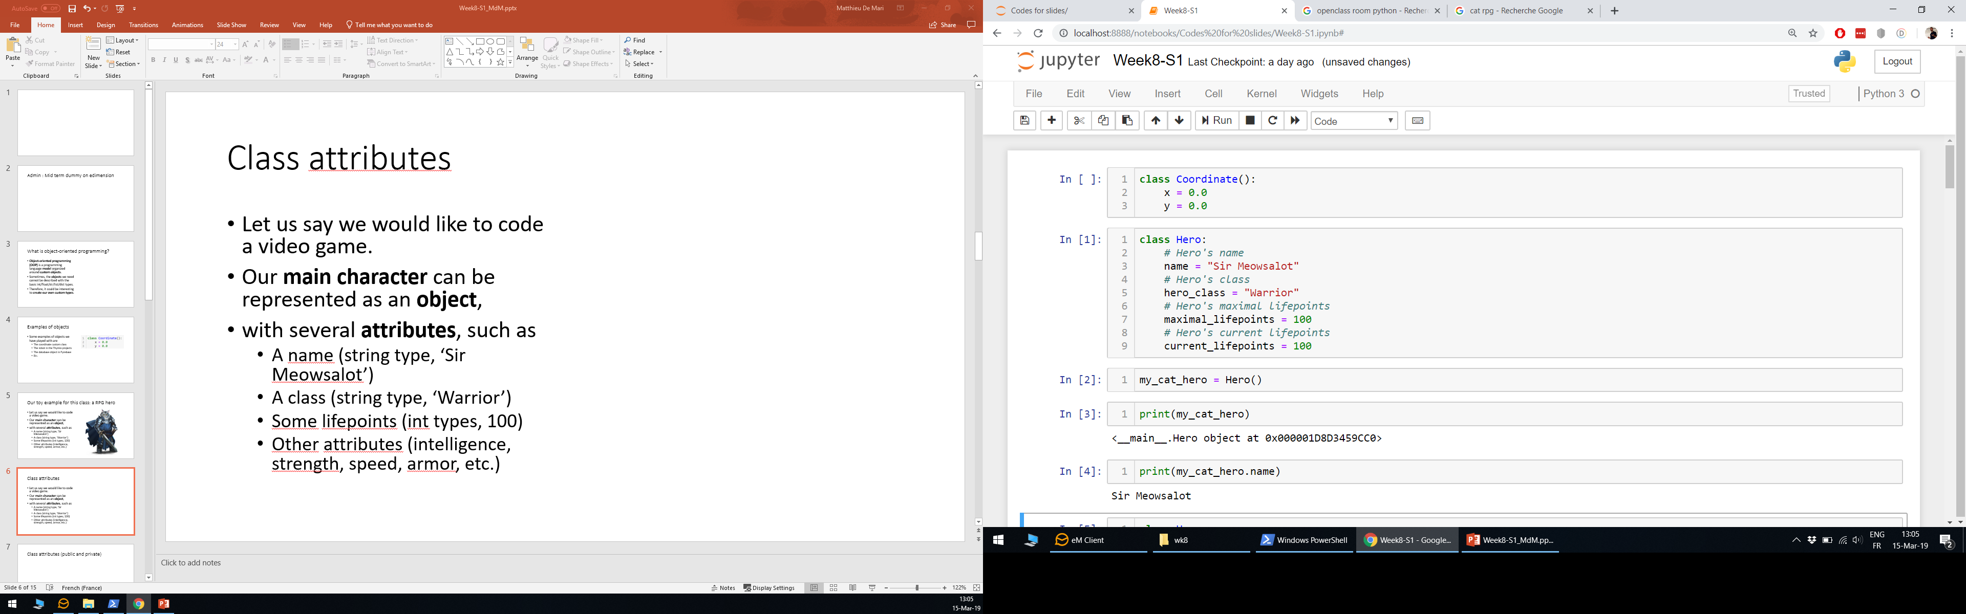
Class attributes
Let us say we would like to code a video game and design our main character.
Our main character can be represented as a custom class object.
It has several attributes, such as
A name (string type, ‘Sir Meowsalot’)
A class (string type, ‘Warrior’)
Some lifepoints (int types, 100)
Other attributes (intelligence, strength, speed, armor, etc.)

Slide 6
Class attributes
Let us say we would like to code a video game and design our main character.
Our main character can be represented as a custom class object.
It has several attributes, such as
A name (string type, ‘Sir Meowsalot’)
A class (string type, ‘Warrior’)
Some lifepoints (int types, 100)
Other attributes (intelligence, strength, speed, armor, etc.)

Slide 7
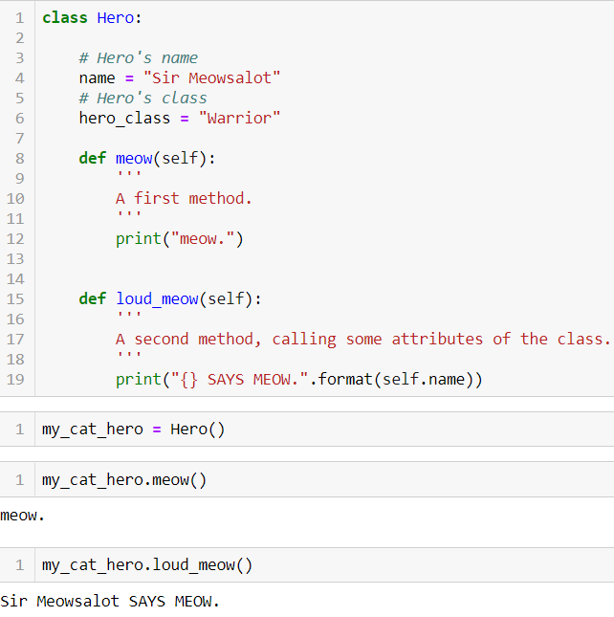
Class methods
On top of a class attributes, we can also define methods.
Methods: functions which apply to our custom object.
Methods may use some of the objects attributes.

Slide 8
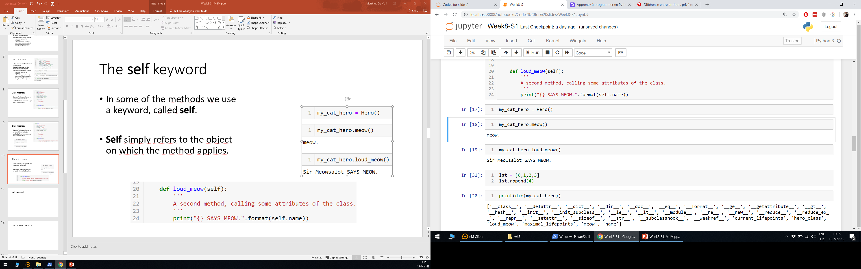
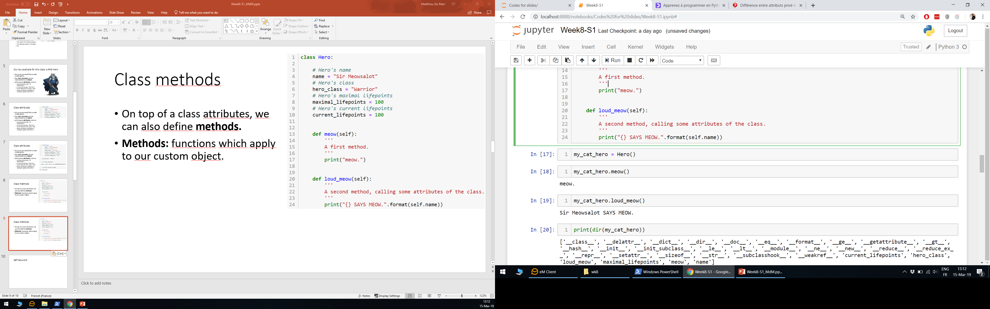
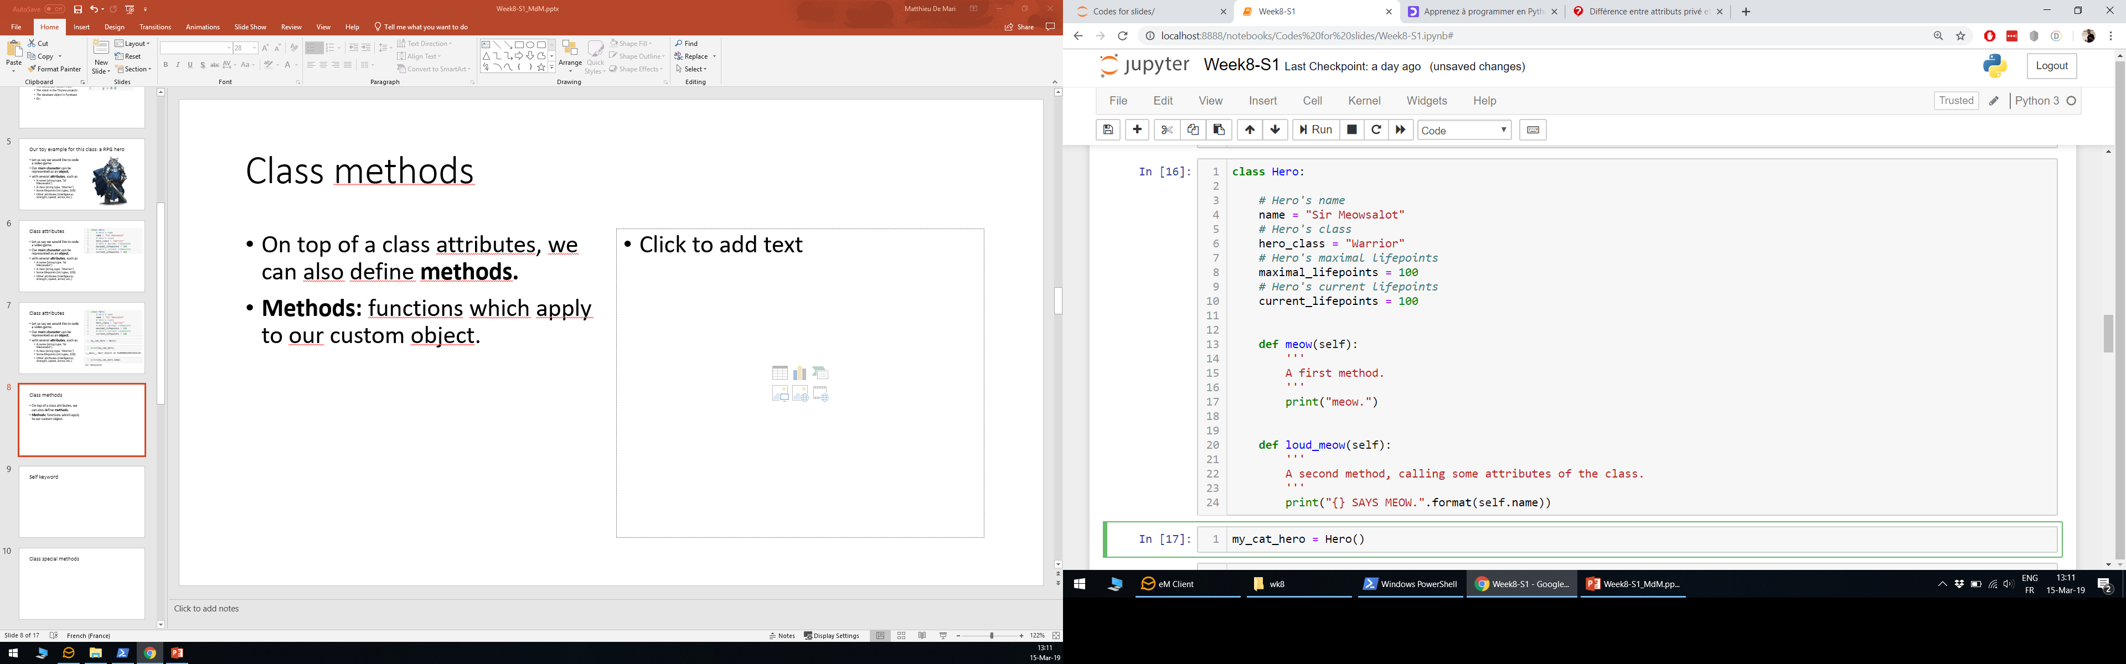
The self keyword
In all the methods we used a keyword, called self.
Self simply refers to the object on which the method applies.
It can also be used to fecth some attributes values of our object!

Slide 9
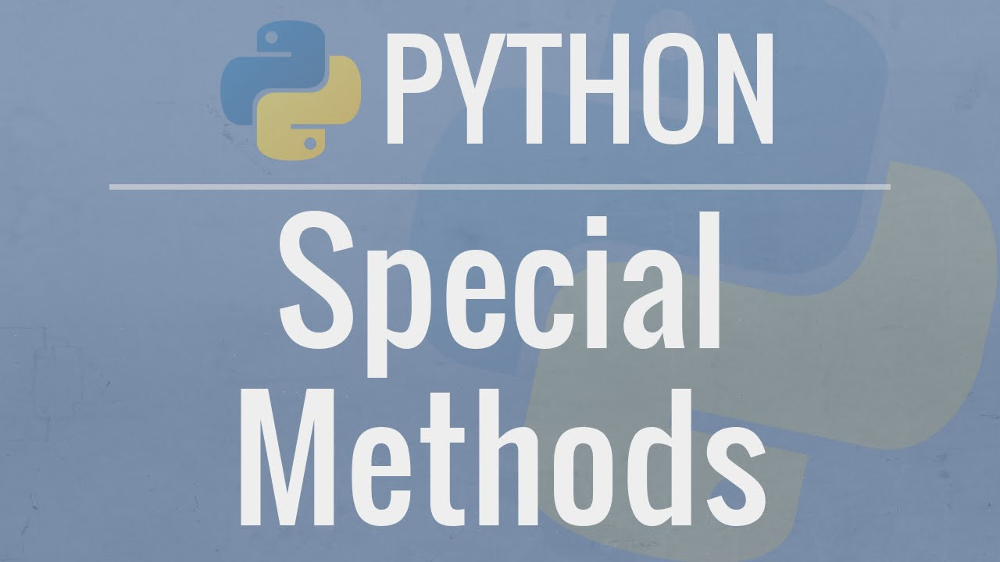
Class special methods
A custom class also has special methods.
These methods are written with double underscores (__) before and after their names.
These methods do something special when some basic operations are applied to our object.
(More on this later!)

Slide 10
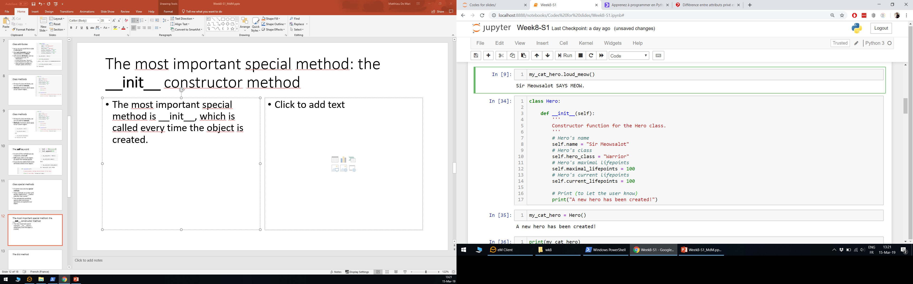
The most important special method: the __init__ constructor method
The most important special method is __init__, which is called every time an object is created.
This is called the constructor method of the class.

Slide 11
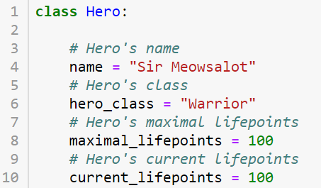
The __init__ constructor vs. « trash » initialization

Slide 12
The __init__ constructor vs. « trash » initialization
It is often preferable to define and use the __init__ method!
It is considered good practice
Allows for more actions on initialization.

Slide 13
The __init__ constructor vs. « trash » initialization
It is often preferable to define and use the __init__ method!
It is considered good practice
Allows for more actions on initialization.

Slide 14
The __init__ constructor vs. « trash » initialization
It is often preferable to define and use the __init__ method!
It is considered good practice
Allows for more actions on initialization.

Slide 15
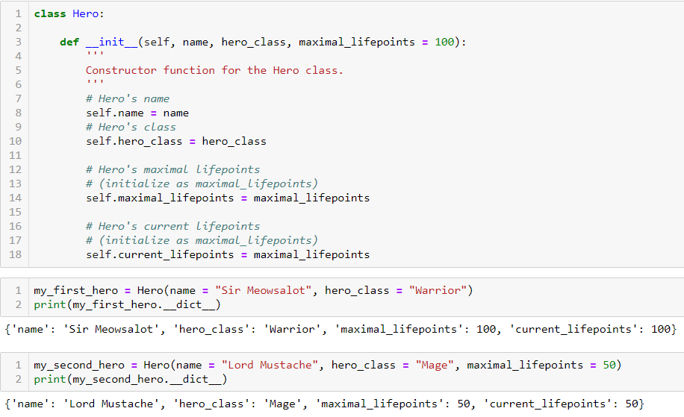
While we’re at it, let us talk about default values in methods and functions
We can also define inputs and default values in our methods and special methods.
Here __init__ expects a name and a hero_class, as mandatory inputs.

Slide 16
While we’re at it, let us talk about default values in methods and functions
We can also pass an optional input, the maximal_lifepoints value.
If no value is passed for maximal_lifepoints, we initialize it, by default, to 100.

Slide 17
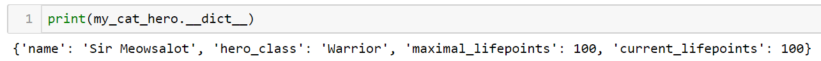
The __dict__ special attribute
Another useful concept is the special dictionnary attribute, called __dict__.
By default, it produces a dictionnary containing
all the attributes of your object,
and their currently assigned values.
(Looks familiar?)

Slide 18
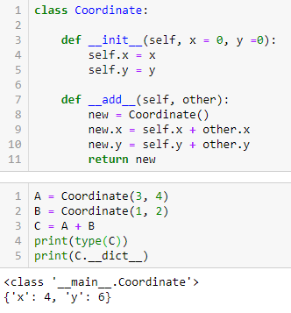
About special methods
We have seen some special methods, such as __init__.
But there are many more methods, such as __add__, which defines the bahavior when two objects of our custom class are summed with +.
Typically, we will have special methods for each operator (+, -, *, /, etc.), and built-in function (len, print, etc.) in Python.

Slide 19

About special methods
We have seen some special methods, such as __init__.
But there are many more methods, such as __add__, which defines the bahavior when two objects of our custom class are summed with +.
Typically, we will have special methods for each operator (+, -, *, /, etc.), and built-in function (len, print, etc.) in Python.

Slide 20

The str special method
The __str__ special method defines what happens when you attempt to convert your custom object into a string type object.
It is typically useful to decide what should be displayed on screen when you attempt to print() your object!

Slide 21
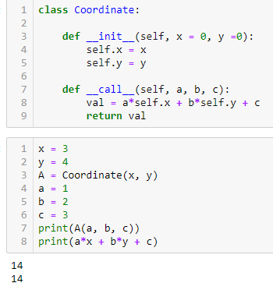
Call method
The __call__ special method defines what happens when you attempt to call your custom object as a function and pass it some arguments.

Slide 22
Call method
The __call__ special method defines what happens when you attempt to call your custom object as a function and pass it some arguments.
REVELATION: This basically means that functions defined with def are nothing but variables with a __call__ method containing your instructions.

Slide 23
Our toy example for this class: a RPG hero
Let us get back to our Hero object.
Problem: our Hero’s attack capabilities probably depend on the weapon he has equipped.
And that is probably an object as well!

Slide 24
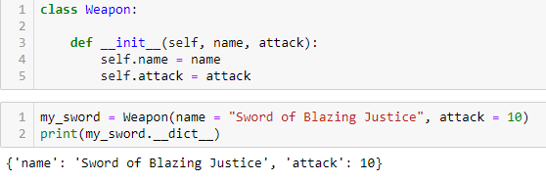
Introducing a Weapon class object!
Reusing the previous concepts, we could define a Weapon object
It will have its own attributes, such as
a name
and some attack values.

Slide 25
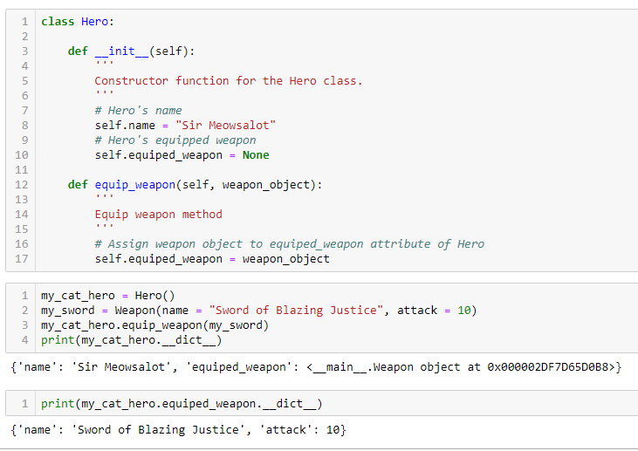
Equip a weapon! (a.k.a the « has-a » relationship)
We can then have our Hero equip a Weapon object, with our own equip_weapon() method.
It assigns a custom Weapon object (which we created earlier)
to the attribute equiped_weapon
of our Hero object.
Our Hero can then equip a Weapon object, with our equip_weapon() method.

Slide 26
The « has-a » relationship
We can then force our Hero to equip a Weapon object, with our own equip_weapon method.
We then say that our Hero object « has-a » Weapon object.
Because one of our Hero object’s attributes is a Weapon object.
Hero object
Weapon object
« has-a »

Slide 27
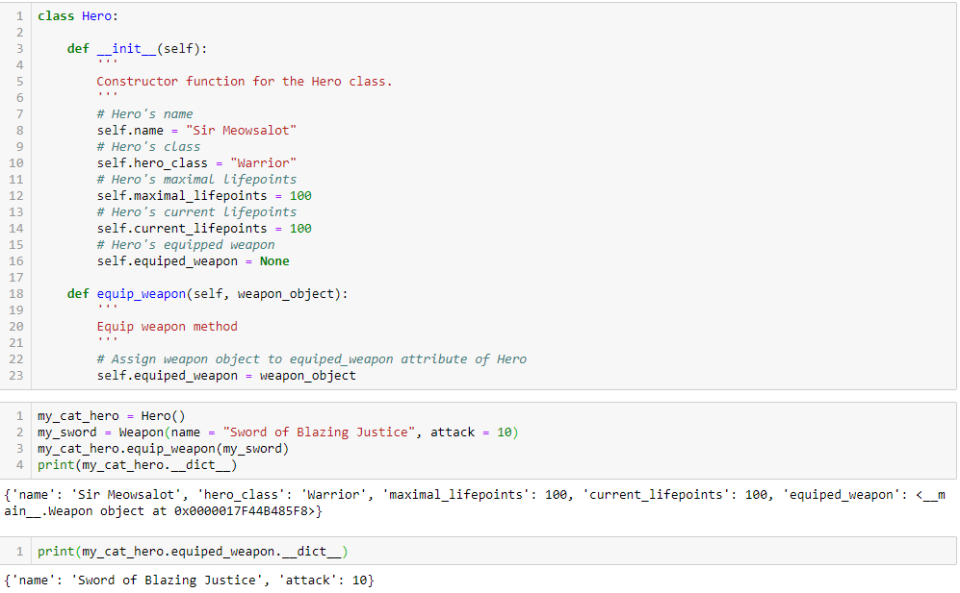

Slide 28
Conclusion
From object dictionaries to proper objects
Attributes, methods and constructor method
The __dict__ special attribute
About special methods
Has-a relationship
If time allows,
(Is-a relationship and inheritance)
(Attributes privacy)
(Setters, getters and properties)

Slide 29
Modifying our Weapon class object
Earlier, we defined a Weapon object, with attributes such as name and attack values.
Problem: how do we efficiently take into account multiple weapons possibilities?

Slide 30
Objects and sub-classes of objects
Typically, our Hero could equip a Weapon object...
But it could be a sword, a bow, a staff, etc.
These weapons will probably have attributes and methods in common…
But they might also have different attributes and methods, as our Hero will probably operate those weapons differently.
Weapon object
Sword object
Bow object
Staff object
Etc.

Slide 31
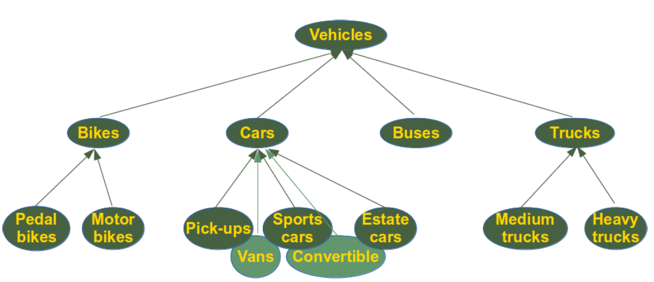
Objects and sub-classes of objects
In fact, it is common in life to have objects and sub-classes of objects.
Cars, buses and trucks probably have some attributes and methods in common, because they are vehicles objects.
But they probably have attributes and methods that are specific to them.

Slide 32
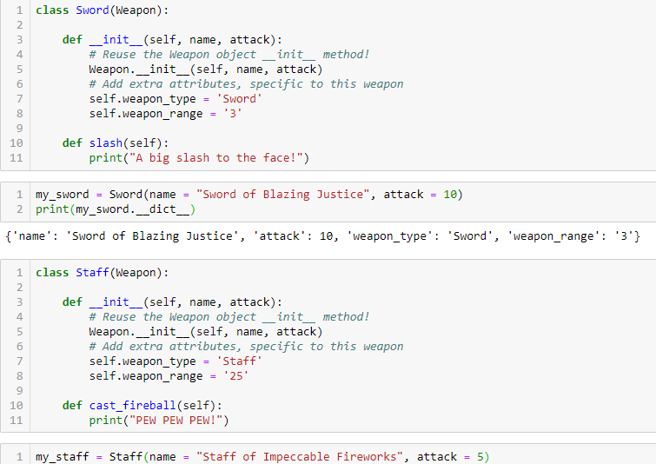
Introducting inheritance! (a.k.a. the « is-a » relationship)
Inheritance: it is possible to create a class, which reuses methods and attributes from another class!
We simply mention the name of the previous class in the class definition!

Slide 33
Introducting inheritance! (a.k.a. the « is-a » relationship)
Inheritance: it is possible to create a class, which reuses methods and attributes from another class!
We simply mention the name of the previous class in the class definition!
And reuse the __init__ constructor from the previous class in the __init__ constructor of new class!

Slide 34
Inheritance and « is-a » relationship
Inheritance is very useful
it allows for code reuse
and better architecture of the objects in your code!
Inheritance defines a « is-a » relationship between objects
Sword object
Weapon object
« is-a »

Slide 35
Let us then equip a sword and/or a staff on our beloved cat Hero!

Slide 36
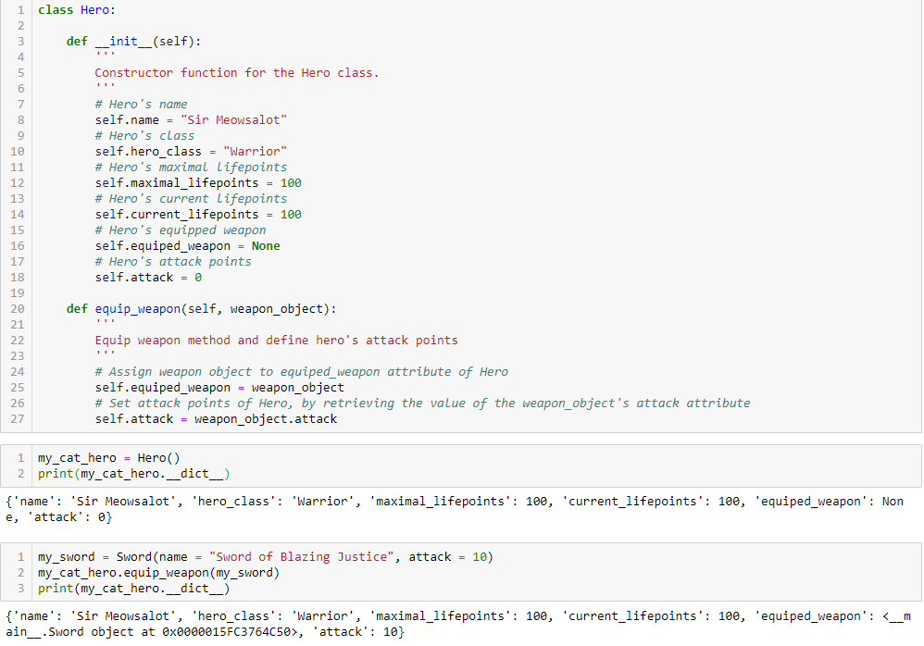
Let us then equip a sword on our beloved cat Hero!

Slide 37
Good practice in Object-Oriented Programming
As mentionned earlier, using __init__ constructors for your class is considered good practice.
In addition, it could also be interesting to use setters and getters methods for your class attributes.
And also, to define if your class attributes should be public or private.

Slide 38
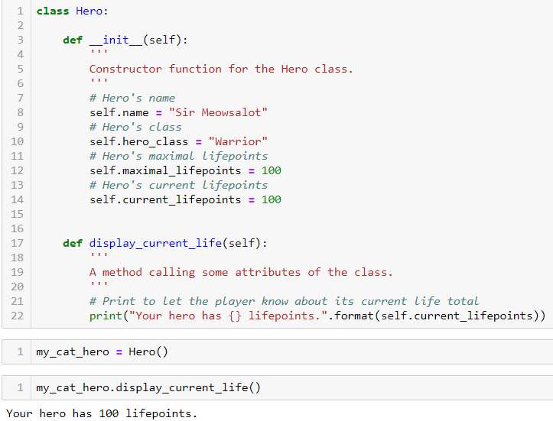
Display lifepoints method
Let us say we want to design a method that prints the current lifepoints of our Hero on screen.
A possible way to do it is this →
And it works just fine!
However, this is considered bad practice.

Slide 39
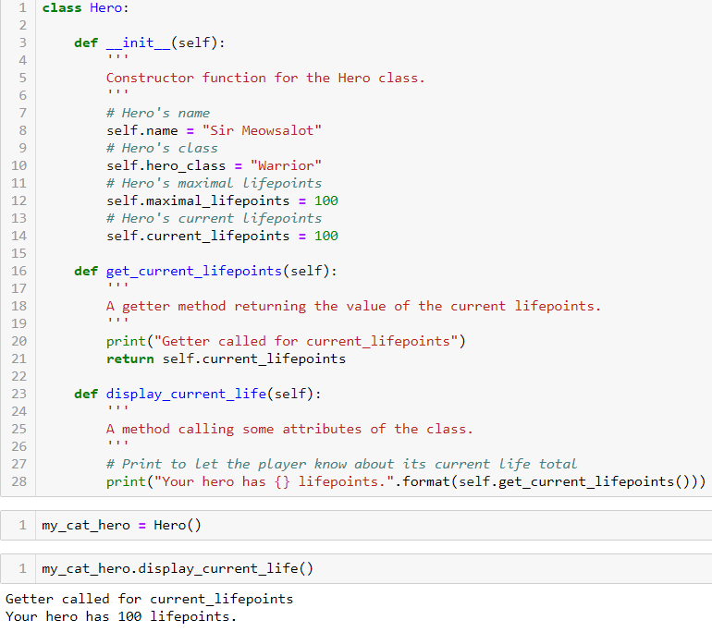
Setters and getters
Good practice: design methods for getting and setting attributes of a class
Getter method: fetches the current value stored in attribute.
Here, we demonstrate an example of a getter method.
And apply it in our display_current_life method.

Slide 40
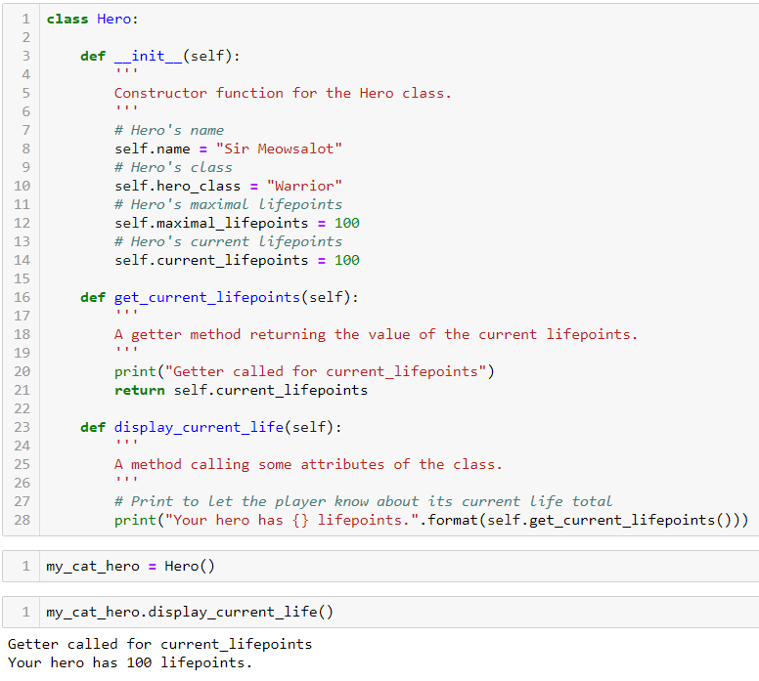
Why is it good practice to use setters and getters?
But, why would I write a getter method?!
It seems cumbersome for no reason!

Slide 41
Why is it good practice to use setters and getters?
But, why would I write a getter method?!
It seems cumbersome for no reason!
Actually, it makes your code more modular and stable.

Slide 42
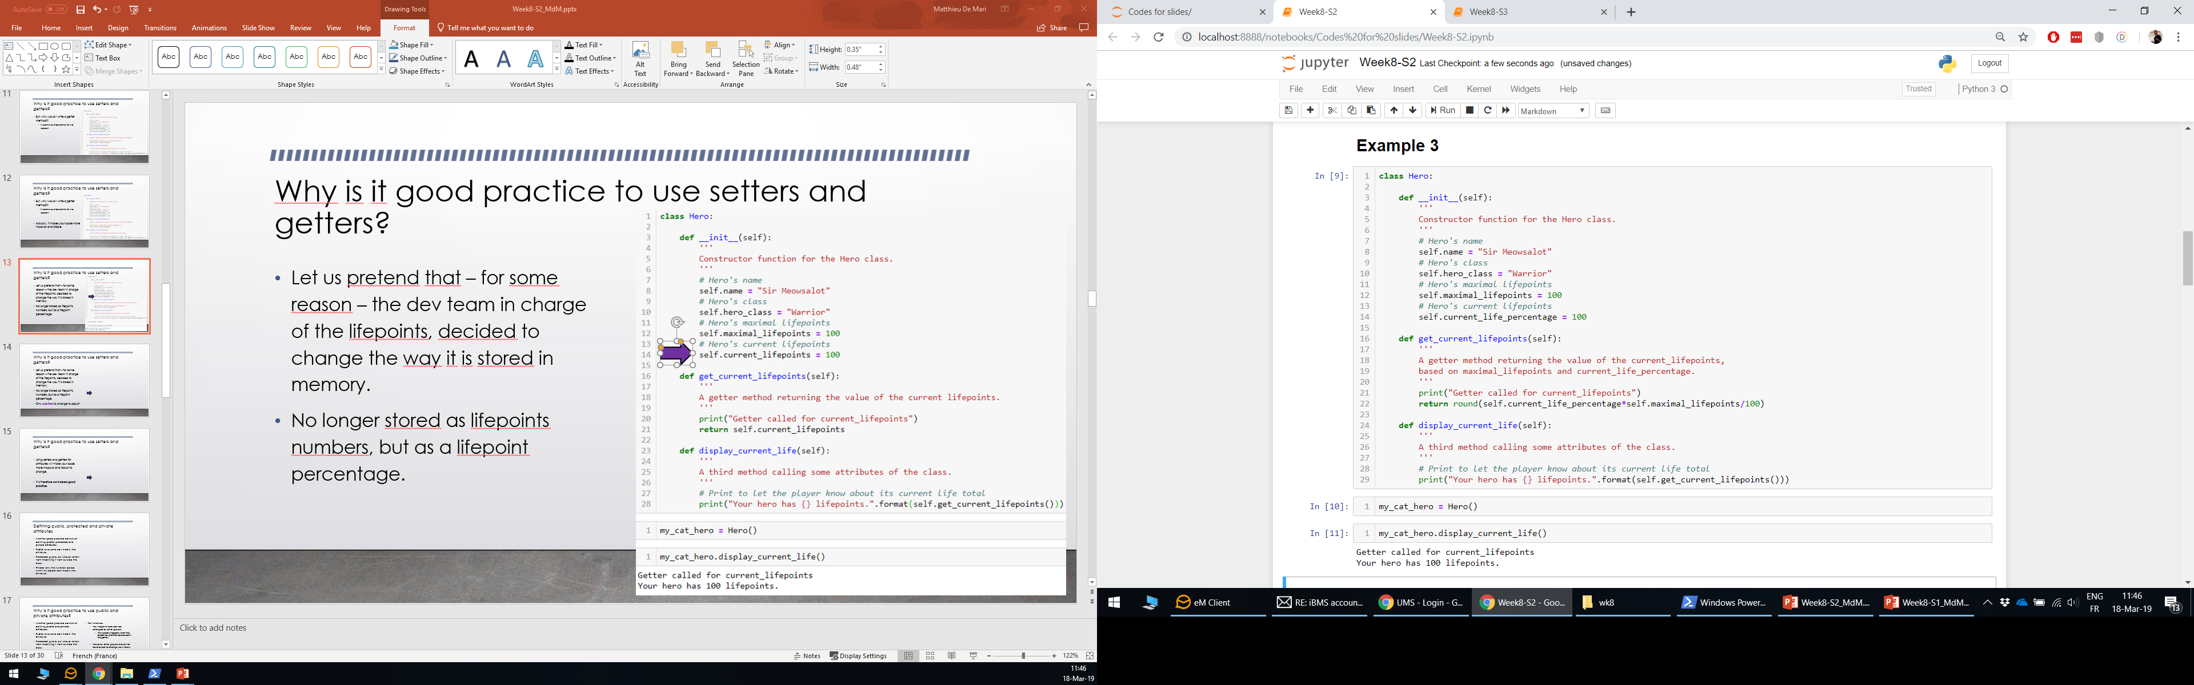
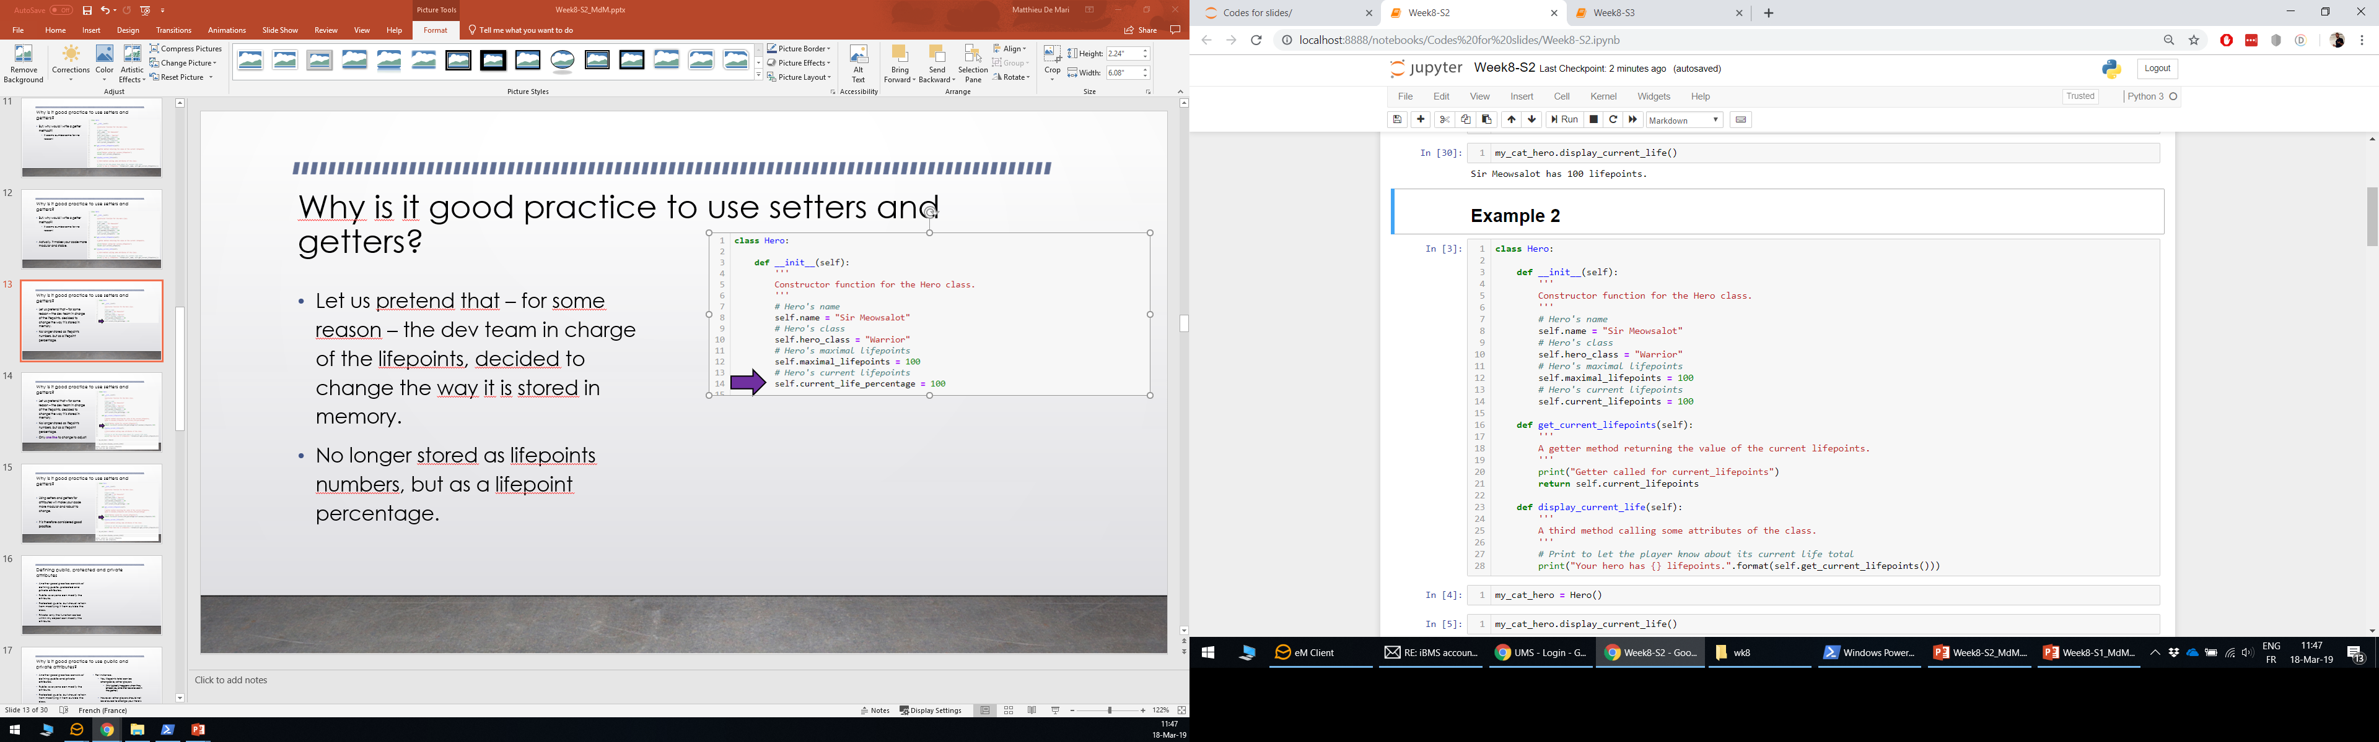
Why is it good practice to use setters and getters?
Let us pretend that – for some reason – the dev team in charge of the lifepoints, decided to change the way it is stored in memory.
No longer stored as lifepoints numbers, but as a lifepoint percentage.
These methods no longer work!

Slide 43
Why is it good practice to use setters and getters?
Let us pretend that – for some reason – the dev team in charge of the lifepoints, decided to change the way it is stored in memory.
No longer stored as lifepoints numbers, but as a lifepoint percentage.
But, only one line to change to make it work again!

Slide 44
Why is it good practice to use setters and getters?
Using setters and getters for attributes will make your code more modular and robust to change.
It is therefore considered good practice.

Slide 45
Defining public, protected and private attributes
Type of attribute | Public | Protected | Private
Can be modified within the class methods. | Yes | Yes | Yes
Can be modified by function and methods outside of the class. | Yes | Yes | No
It is acceptable for this attribute to be modified by functions and methods outside the class. | Yes | No | Does not apply
Another good practice consists of defining public, protected and private attributes.
Public: everyone can modify the attribute.
Protected: public, but should refrain from modifying it from outside the class.
Private: only the functions called within my object can modify the attribute.

Slide 46
Why is it good practice to use public, protected and private attributes?
Another good practice consists of defining public, protected and private attributes.
Public: everyone can modify the attribute.
Protected: public, but should refrain from modifying it from outside the class.
Private: only the functions called within my object can modify the attribute.
For instance,
Your lifepoints total can be changed by other players
(this typically happens when they attack you and shall be allowed in the game!)
However, other players should not be allowed to change your Hero’s name!

Slide 47
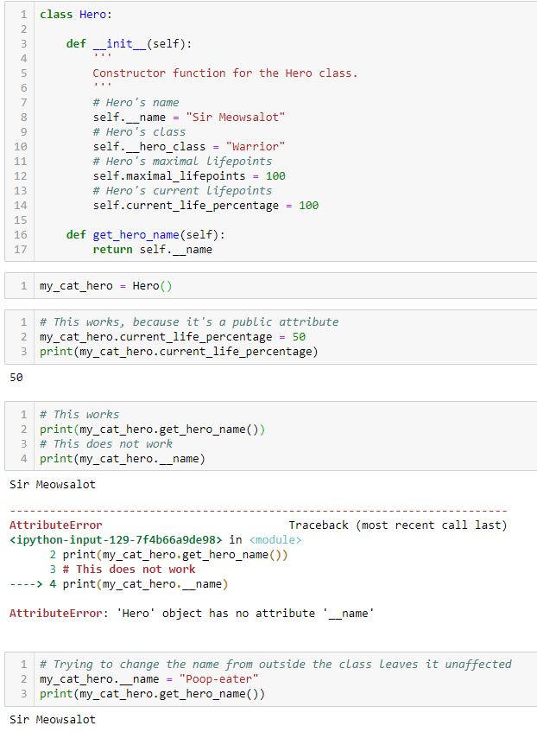
Private attributes
Private: only the functions called within my object can modify the attribute.

Slide 48
Private attributes
Private: only the functions called within my object can modify the attribute.
We can make an attribute private by adding a double underscore (__) in front of its name.
Calling it or modifying it has no effect.

Slide 49

Protected attributes
Protected: public, but should refrain from modifying it from outside the class.
We can make an attribute protected by adding a single underscore (_) in front of its name.

Slide 50
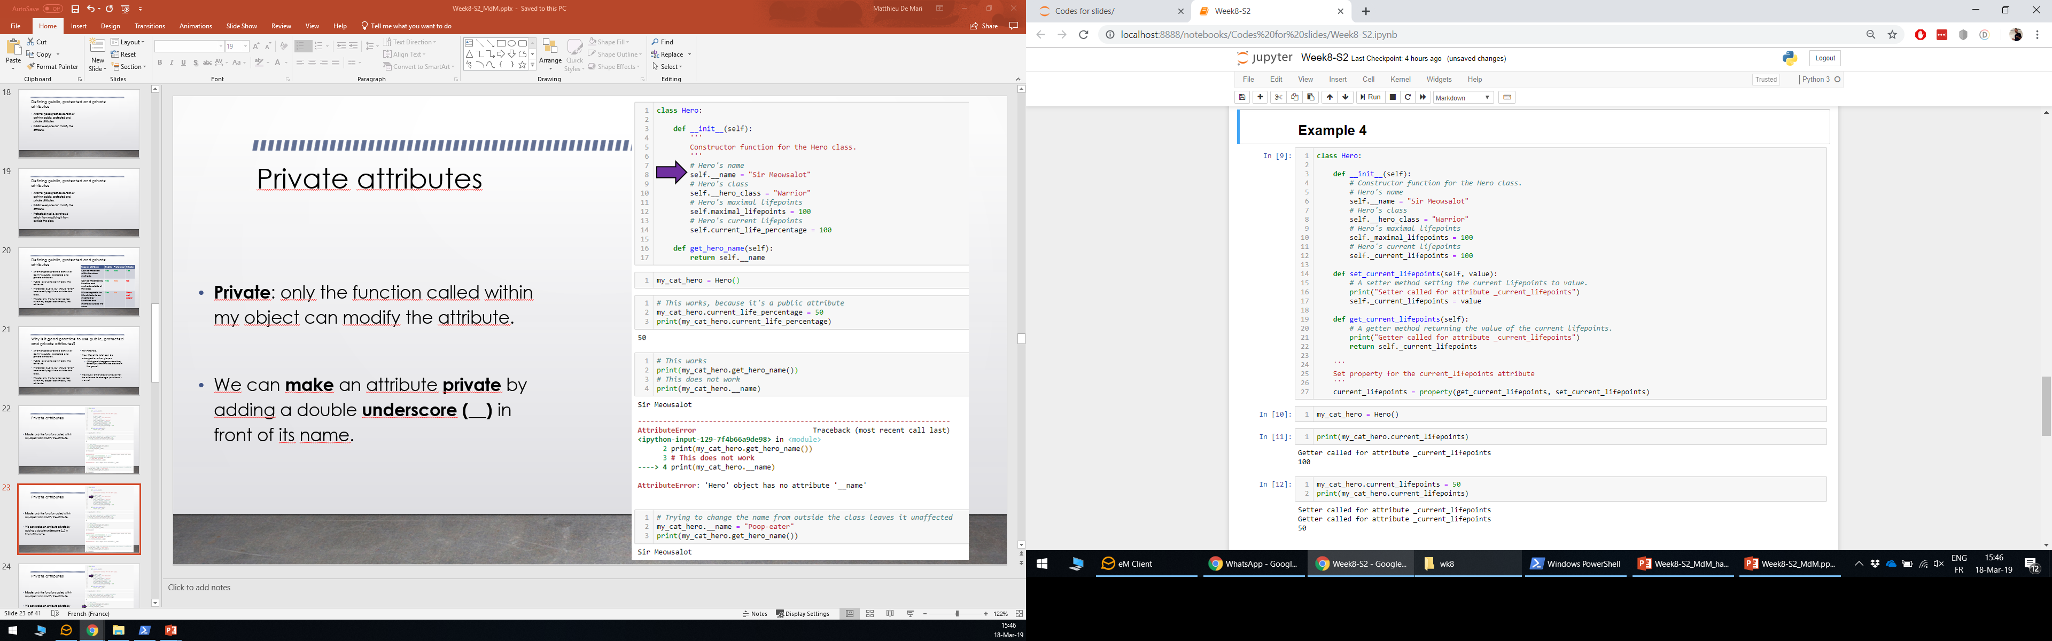
Merging everything, by setting attributes properties using the property keyword
Last but not least, it is also considered good practice to create properties.
i.e default setter/getter methods for each attribute.
It is done with the property keyword.

Slide 51
Merging everything, by setting attributes properties using the property keyword
Thanks to the property keyword…
Whenever we execute my_cat_hero.current_lifepoints, we automatically call the getter method, i.e.
my_cat_hero.get_current_lifepoints()

Slide 52
Merging everything, by setting attributes properties using the property keyword
And similarly, with the setter method, when we try to assign a value to our attribute.

